Slide 1
Chapter 14 Classification Trees and Rule-Based Models
By Kayla X
8/3/2020

Slide 2
14.1 Basic Classification Trees
Purity-maximizing accuracy by minimizing misclassification error
Accuracty-a measure of purity
Gini index/crossentropy-referred to as deviance or information, shift focus from accuracy to purity.
Gini index is maximized when p1=p2(when node is least pure)

Slide 3
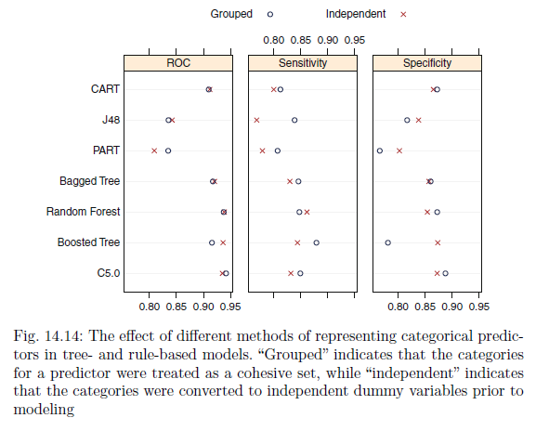
when fitting trees and rule-based models, the practitioner must make a choice regarding the treatment of categorical predictor data
Grouped categories
Decomposed categorical predictors into binary dummy variables, called independent categories

Slide 4
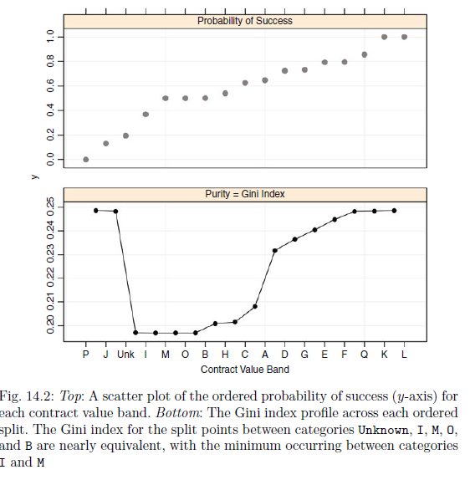
CART and C4.5 classification trees are the most widely used model for categorial predictor
Adding samples from the Unknown category to the samples from categories P and J greatly reduces the Gini index.
While it is difficult to see from the figure, the minimum value occurs at the split point between categories I and M. Therefore, the algorithm chooses to place samples from contract value band I, J, P, and Unknown into one partition and the remaining samples into the other.
Using only this split, the model would classify a new sample as unsuccessful if it had a contract value band of I, J, P, or Unknown and successful otherwise.

Slide 5
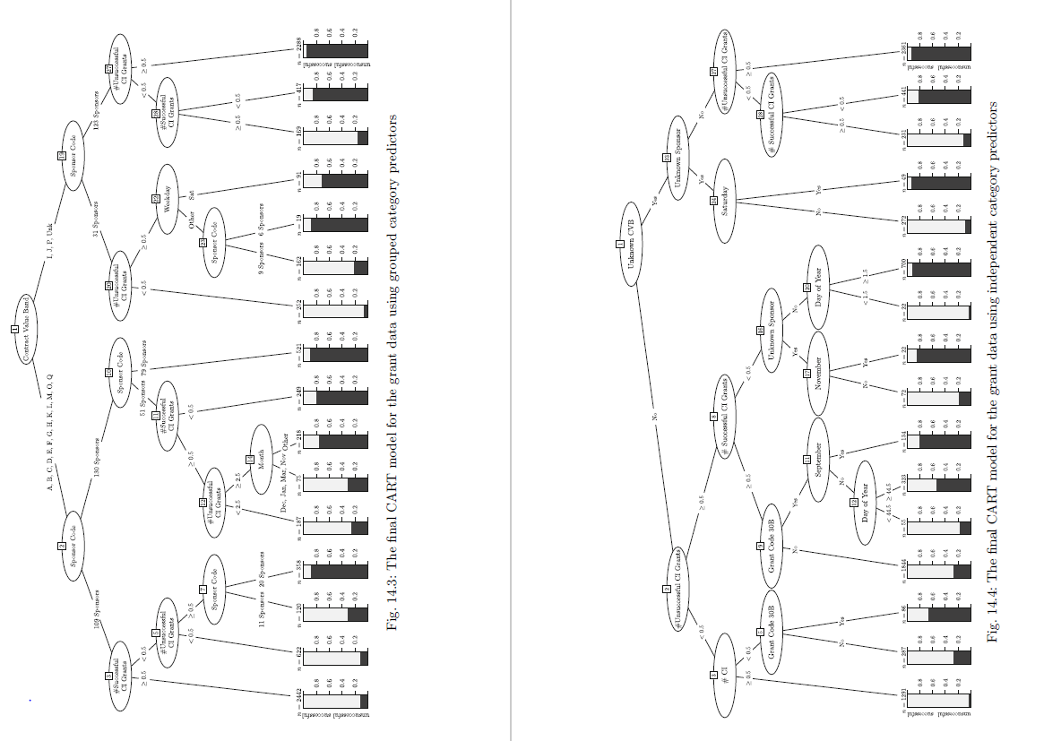
Notes:
For classification trees using CART, there is no practical
difference in predictive performance when using grouped categories or
independent categories predictors for the grant data.
the independent category tree is much easier to interpret than the
grouped category tree

Slide 6


How to determining splits
Information statistics-for uncertainty of a class,bigger info, higher uncertainty
Using information gain to split
Notes:
Information statistics

Slide 7
14.2 Rule Based Model
rule-based models consist of one or more independent conditional statements
C4.5Rules
Given this initial set, each rule is evaluated individually to assess whether
it can be generalized by eliminating terms in the conditional statement.
For a rule, the model first calculates a baseline pessimistic error rate, then removes each condition in the rule in isolation. Once a condition is removed, the pessimistic error rate is recomputed. If any error rate is smaller than the baseline, the condition associated with the smallest error rate is removed. The process is repeated until all conditions are above the baseline rate or all conditions are removed

Slide 8
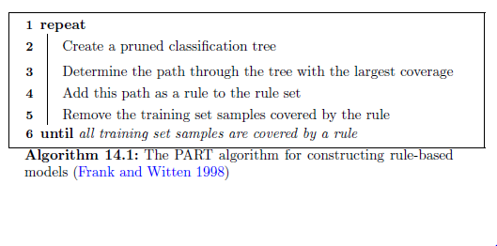
Part
a new rule can adapt to the previous set of rules and may more effectively capture important
trends in the data.

Slide 9
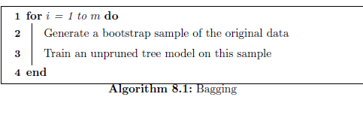
14.3 Bagged Tree
Bagging for classification is a simple modification to bagging for regression
each model in the ensemble is used to predict the class of the new sample.

Slide 10
14.4 Random Forest
a classification tree is used in place of regression tree
The model is relatively insensitive to values of mtry.
As with most trees, the data pre-processing requirements are minimal.
Out-of-bag measures of performance can be calculated, including accuracy,sensitivity, specificity, and confusion matrices.

Slide 11
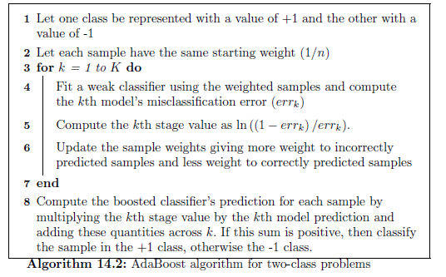
14.5 Ada Boosting
AdaBoost generates a sequence of weak classifiers,
where at each iteration the algorithm finds the best classifier based on
the current sample weights.

Slide 12
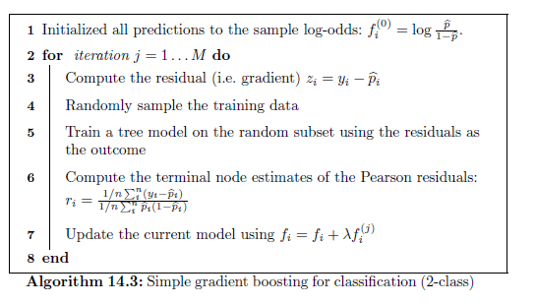
Stochastic Gradient Boosting

Slide 13
14.6 C5.0
C5.0 is a more advanced version of Quinlan’s C4.5 classification model that has additional features, such as boosting and unequal costs for different types of errors.
Like C4.5, it has tree- and rule-based versions and shares much of its core algorithms with its predecessor.
Unlike C4.5 or Cubist, there is very little literature on the improvements and our description comes largely from evaluating the program source code

Slide 14
14.7 Comparing Two Encodings of Categorical Predictors
It is difficult to extrapolate all findings to other models and other data sets, and, for this reason, it may be worthwhile to try both encodings during the model training phase.

